Slide 1
INTERNATIONAL STUDENTS IN AUSTRALIA FORECAST

Slide 2
Current interest
Education is Australia’s one of the primary sources of income with 5 Billion AUS generated in 2018
International students represent about 26.7% of the entire student body
COVID-19 has induced a lot of uncertainty in the future of Australia’s international student enrolments.
Our aim was to forecast the number of students who will be enrolling at Australian universities in the future.

Slide 3
Data Acquisition
Two sets of data required
Number of visa applications lodged with the Department of Home Affairs
Acquired from [1]
Number of enrolments in the education sector
Acquired from [2]
[1] – https://data.gov.au/dataset/ds-dga-324aa4f7-46bb-4d56-bc2d-772333a2317e/details
[2] - https://internationaleducation.gov.au/research/International-Student-Data/Pages/InternationalStudentData2020.aspx

Slide 4
Data Cleaning
Visa lodged dataset
2019-2020 data omitted as the entire years hasn’t passed
Omit the secondary applicants
Group the data by sectors
Enrolments dataset
Remove all the duplicates
Omit all categories except hospitals and emergency centres (Labs, dentists, etc.)

Slide 5
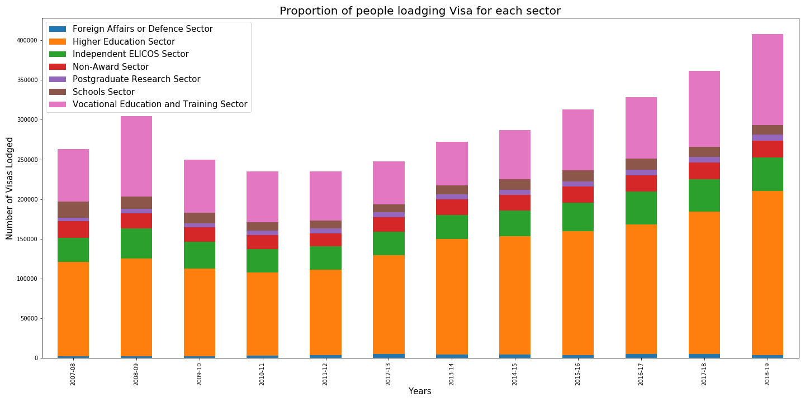
Proportion of people enrolling in each sector
Most people enrol in higher education sector

Slide 6
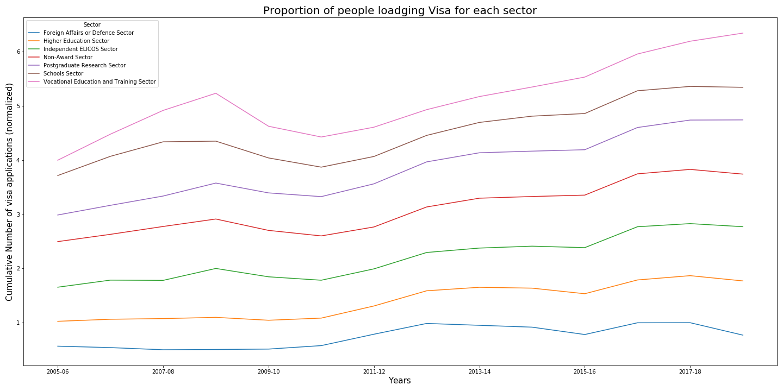
Trends of people enrolling in each sector
We see a similar trends in all the sectors

Slide 7
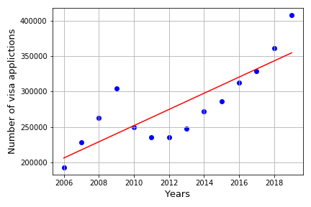
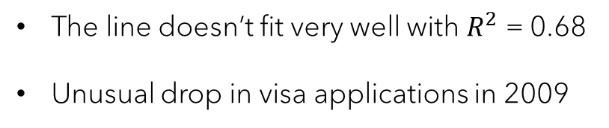
Number of visa applicants over the years
The line doesn’t fit very well with $R^{2}$ = 0.68
Unusual drop in visa applications in 2009

Slide 8
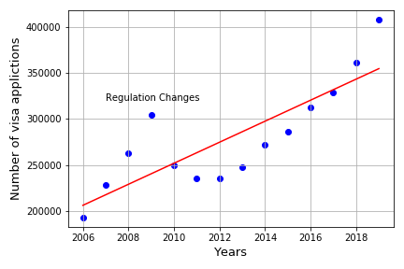
Number of visa applicants over the years
The line doesn’t fit very well with $R^{2}$ = 0.68
Unusual drop in visa applications in 2009

Slide 9
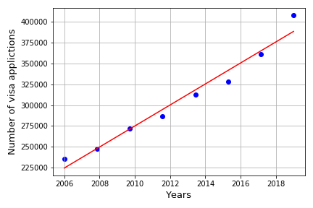

Number of visa applicants over the years
The line fit very well with $R^{2}$ = 0.96

Slide 10
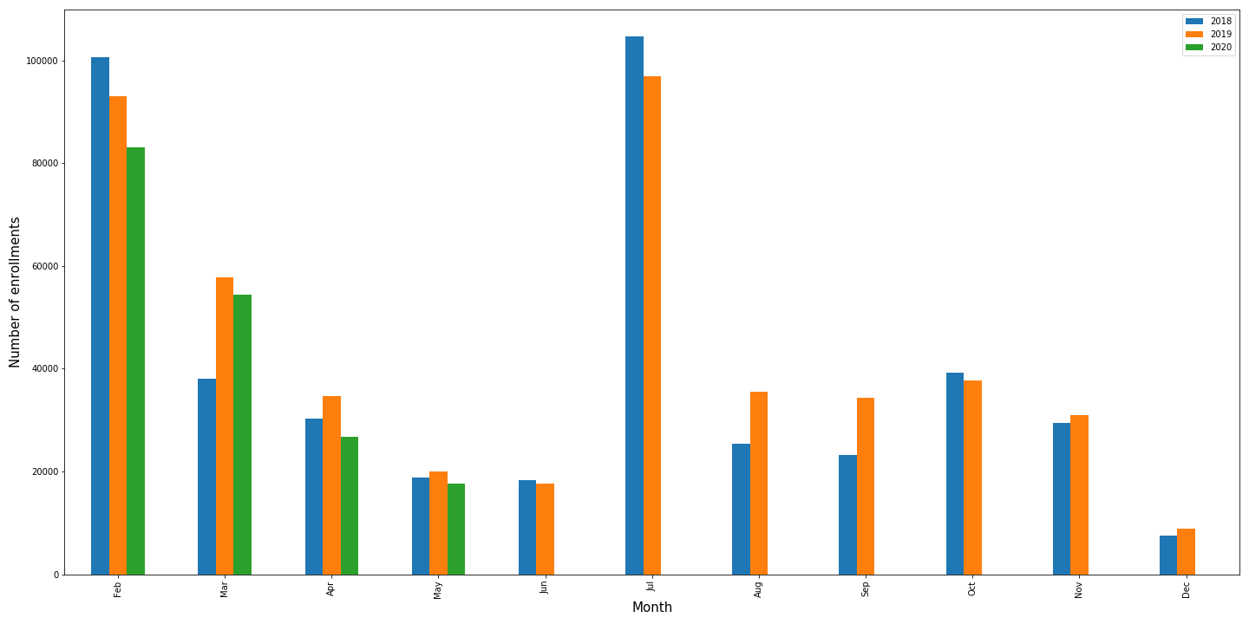
Enrolments over the months (17-20)
The enrolments are distributed over different months

Slide 11
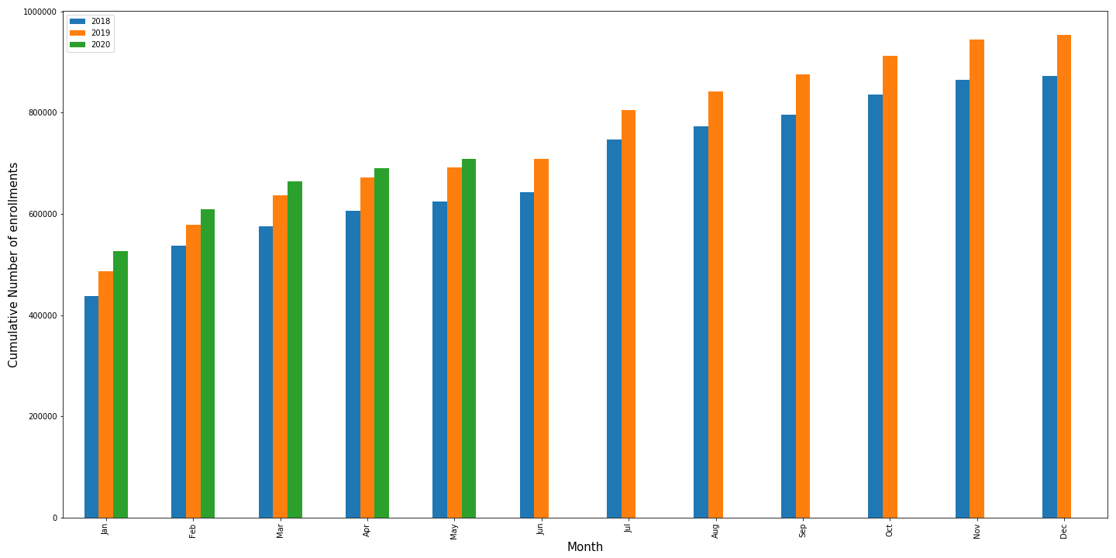
Cumulative Enrolments over the months (17-20)
The enrolments are distributed over different months

Slide 12
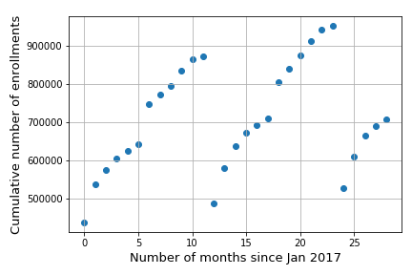
Cumulative Enrolments over the months (17-20)
The enrolments are distributed over different months

Slide 13
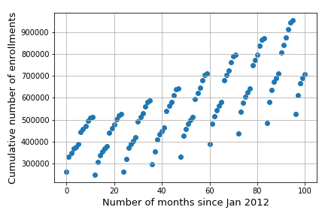
Cumulative Enrolments over the months (12-20)
The enrolments are distributed over different months

Slide 14
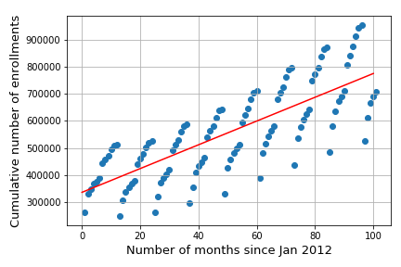
Growth in enrolments over the months (12-20)
There was an growth of 9.18% every year for the past 8 years

Slide 15
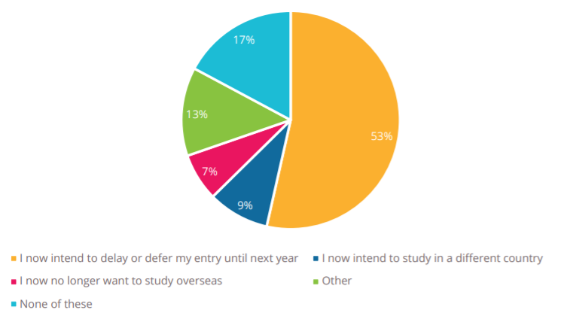
Student survey by QS
About 60% students don’t intend to join any Australian universities before 2021
https://www.qs.com/portfolio-items/the-impact-of-the-coronavirus-on-prospective-international-students/

Slide 16
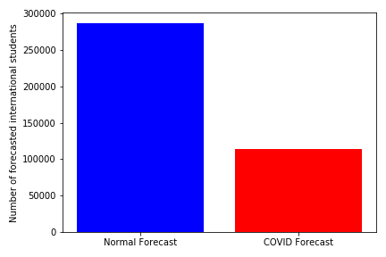
Forecast
Enrolments if it were normal vs the forecast made post COVID19
Normal Forecast = 286284 students
COVID Forecast = 114513 students

Slide 17
Conclusion
Drop in visa applications in 2009 due to regulation changes
A recurring pattern in cumulative number of enrolments every years is observed
There was an average growth of 9.18% every year from 2012-2019
About 60% of students do not intend to join any Australian universities in 2020
The predicted forecast suggests that there will be approximately 114513 enrolments by Dec 2020 compared to 286284 in the normal forecast.

